Slide 1

ABSTRACT PRESENTATION ON ADMISSION PREDICTION FOR HIGHER STUDIES IN FOREIGN UNIVERSITIES BY G. TOBY MERCHANT 19311A12N6 MOHAMMED SAMIUDDIN 19311A12M3 T. MANOHAR 19311A12P1 UNDER THE GUIDANCE OF Dr . K. KRANTHI KUMAR ASSOCIATE PROFESSOR, DEPT OF IT
DEPT OF IT, SREENIDHI INSTITUTE OF SCIENCE AND TECHNOLOGY
YAMNAMPET,GHATKESAR

Slide 2
ABSTRACT
Abstract
Newly graduate students usually are not knowledgeable of the requirements and the procedures of the postgraduate admission and might spend a considerable amount of money to get advice from consultancy organizations to help them identify their admission chances.
The present system focuses on the Admission prediction by using algorithms such as Adaboost Algorithm, Support Vector Machine and Naive Bias.
This is implemented to predict the admission of the students by their scores before selecting the colleges. To overcome this an model is implemented.
This model is going to be improved by using other algorithms and gives us the best results by training the dataset.

Slide 3
CONTENTS
Contents
Problem Statement
Literature Survey
Existing System
Proposed System Architecture
Proposed System Algorithm
Experimental Setup
Database Description
Conclusion

Slide 4
PROBLEM STATEMENT
Problem Statement
Prediction of college admission through Graduate Record Examination(GRE), Test of English for Foreign language(TOEFL), University rating, Statement of purpose (SOP),Letter of Recommendation(LOR) and CGPA Scores by using Machine learning.

Slide 5
LITERATURE SURVEY
Literature Survey
1. A.Sivasangari, V.Shivani, Y.Bindhu, D.Deepa, R.Vignesh, “ Prediction Probability of Getting an Admission into a University using Machine Learning”, IEEE conference on ICCMC, Tamilnadu, India, May 2021, pp: 1706 – 1709.
This paper suggests Catboost algorithm which gives highest accuracy.
2. Zhenru Wang, Yijie Shi, “Prediction of the Admission Lines of College Entrance Examination based on machine learning”, IEEE conference on ICCC, Paris, France, July 2016, pp: 332-334.
This paper suggest and also uses Adaboost algorithm which gives 80% accuracy.

Slide 6
LITERATURE SURVEY
Literature Survey
3. Md. Omaer Faruq Goni, Abdul Matin, Tonmoy Hasan, Md. Abu Ismail Siddique, Oishi Jyoti, Fahim MD Sifnatul Hasnain,” Graduate Admission Chance Prediction Using Deep Neural Network”, IEEE conference on WIECON-ECE, Bhubhaneswar, India, December 2020, pp: 259-262.
The prediction model follows the Artificial neural network approach.
4. Robert Ries, Mehmet Ozbek, “Predicting the Performance and Success of Construction Management Graduate Students using GRE Scores”.
The prediction model uses the chi-square techniques and logistic regression.

Slide 7
LITERATURE SURVEY
Literature Survey
5. Naveen S.Sapare, Sahana M.Beelagi,” Comparison study of Regression Models for the prediction of Post-Graduation admissions using Machine Learning Techniques” IEEE conference on ICCDSE, January 2021, Uttar Pradesh, India, pp: 822-828
The models uses Ridge regression, Linear regression and support vector study to predict the Admission.
6. Vandit Manish Jain, Rihaan Satia, “College Admission Prediction using Ensemble Machine Learning Models”, IRJET, December 2021, Tamilnadu, India, pp: 403-407
This model uses weka tool to predict the admission by using ANN, Random forests and Decision trees.

Slide 8
EXISTING SYSTEM
Existing System
Existing System 1:
Prediction Probability of Getting an Admission into a University using Machine Learning. (PPGA)
This system explains about the chance of admission using Catboost algorithm and checks the accuracy.
This research is to develop a model that predict the percentage of chances into the university accurately.
There is an accuracy of 95% with Catboost algorithm and is the highest quantitative result.
Prediction Probability of Getting an Admission into a University using Machine Learning.

Slide 9
EXISTING SYSTEM
Existing System
Existing system 2 :
Prediction of the Admission Lines of College Entrance Examination based on machine learning. (PACEE)
This Model helps the prediction to be done at a faster rate by using Adaboost algorithm. It follows reduction method.
Here, machine learning methods are used to carry out the college admission lines of research and prediction.
This Model considers the enrolment plan, number of applicant, the difficulty of test question, and other factors.
The result of this prediction model has important reference value to the students who take part in college entrance examination.
Prediction of the Admission Lines of College Entrance Examination based on machine learning.

Slide 10
EXISTING SYSTEM
Existing System
Existing system 3 :
Graduate Admission Chance Prediction Using Deep Neural Network (GAPDNN)
The prediction model follows the Artificial neural network approach. By using ANN it can predict through the neural networks.
The proposed Deep neural network to predict the chance of getting admitted to a university according to the student portfolio.
The DNN model shows an optimistic outcome in every benchmark and has also outperformed the existing methods.
Graduate Admission Chance Prediction Using Deep Neural Network

Slide 11
PROPOSED SYSTEM ARCHITECTURE
Proposed System Architecture
Input and data analysis
Data pre-processing
Training data set
Testing data set
Linear regression
Random forest
Decision Tree
Chance of Admit
Linear
if R2 score of LR greater than RF & DT
Checking accuracy
Prediction
Test & visualize
RF
if R2 score of RF greater than DF & LR
Model Testing
DT
If R2 score (DT) is greater than RF & LR

Slide 12
PROPOSED SYSTEM ALGORITHM
Proposed system Algorithm
Algorithm : Admission Prediction
Input : User given input
Output : Prediction of Admit
Begin
1. Import dataset
2. Pre-process data
3. Split Dataset
4. Train the model
Notes:
ID3----

Slide 13
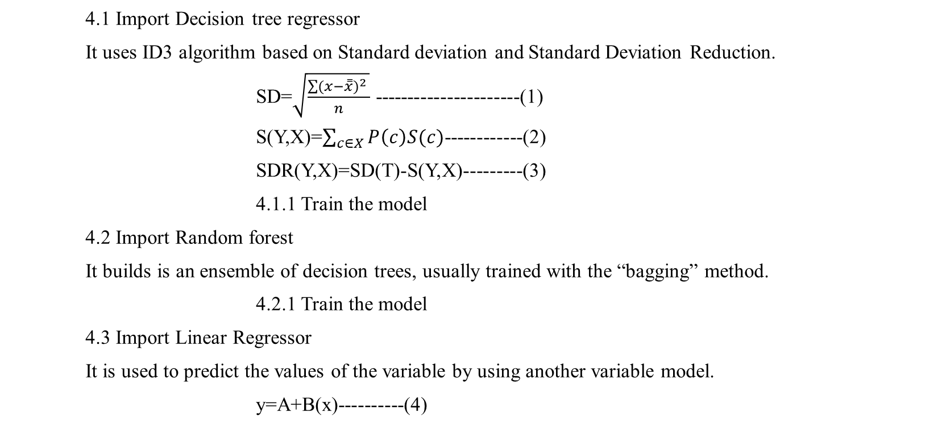
PROPOSED SYSTEM ALGORITHM
Proposed system Algorithm
4.1 Import Decision tree regressor
It uses ID3 algorithm based on Standard deviation and Standard Deviation Reduction.
SD=$\sqrt{\frac{\sum{{(x−\overset{̿}{x})}^{2} }}{n}}$ ----------------------(1)
S(Y,X)=$\sum_{c∈X}{P\left(c\right)S(c)}$------------(2)
SDR(Y,X)=SD(T)-S(Y,X)---------(3)
4.1.1 Train the model
4.2 Import Random forest
It builds is an ensemble of decision trees, usually trained with the “bagging” method.
4.2.1 Train the model
4.3 Import Linear Regressor
It is used to predict the values of the variable by using another variable model.
y=A+B(x)----------(4)

Slide 14

PROPOSED SYSTEM ALGORITHM
Proposed system Algorithm
5. Test the model using testing data
5.1 Test the model
6. Finding the accuracy.
6.1 Mean square Error
MSE=$\frac{1}{2}\sum_{i=0}^{n}{{\left(fi−yi\right)}^{2}}$---------------(5)
6.2 R2 score
$R^{2}=1−\frac{\sum{{(yi−\hat{yi})}^{2}}}{\sum{{(yi−\overline{y})}^{2}}}$--------------------(6)
6.3 Root mean square error
$\sqrt{\frac{Σ{\left(predicted−actual\right)}^{2}}{N}}$----------------(7)
7. User input is given for output
End

Slide 15
EXPERIMENTAL SETUP
Experimental Setup
Hardware Requirements : 4GB RAM, 240GB HARD DISK, 2.5 GHz minimum per core.
Software Requirements : Windows 10
Tools : Jupiter notebook, Anaconda.

Slide 16
DATABASE DESCRIPTION
Database DESCRIPTION
The Dataset consists of 502 records.
For training dataset the model we use 80% of the dataset.
For testing dataset the model we use 20% of the dataset.
The Attributes are
GRE Score
TOEFL Score
University
SOP
LOR
CGPA
Research
Chance of Admit

Slide 17
Database DESCRIPTION
RESEARCH
0
1
GRE SCORE
290-340
TOEFL SCORE
92-120
CHANCE OF ADMIT
0.34-0.97
DATASET
UNIVERSITY RATING
1-5
CGPA
6.8-9.92
LETTER OF RECOMMENDATION
1.0-5.0
STATEMENT OF PURPOSE
1.0-5.0
Fig 2. Schema diagram of dataset
Admission prediction

Slide 18
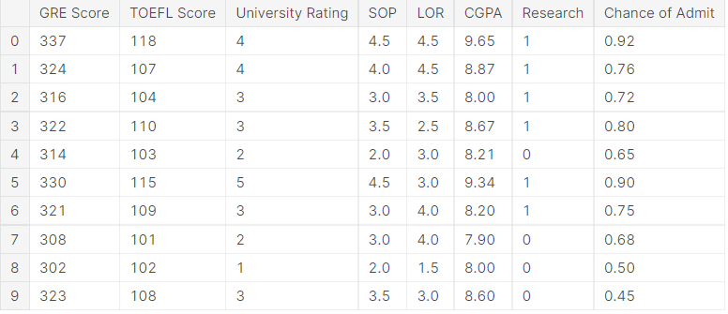
DATABASE DESCRIPTION
DATABASE DESCRIPTION
Dataset has been taken from Kaggle
Dataset.csv

Slide 19
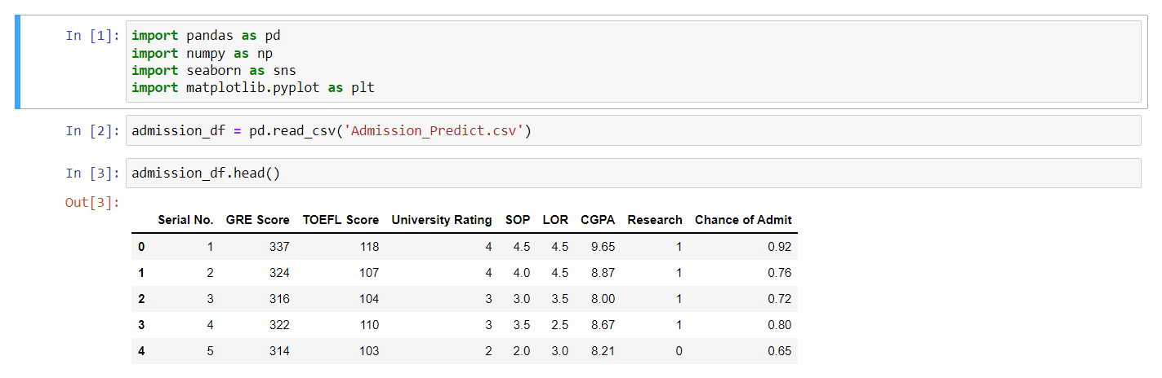
IMPLEMENTATION
1.1 Importing libraries and Dataset

Slide 20
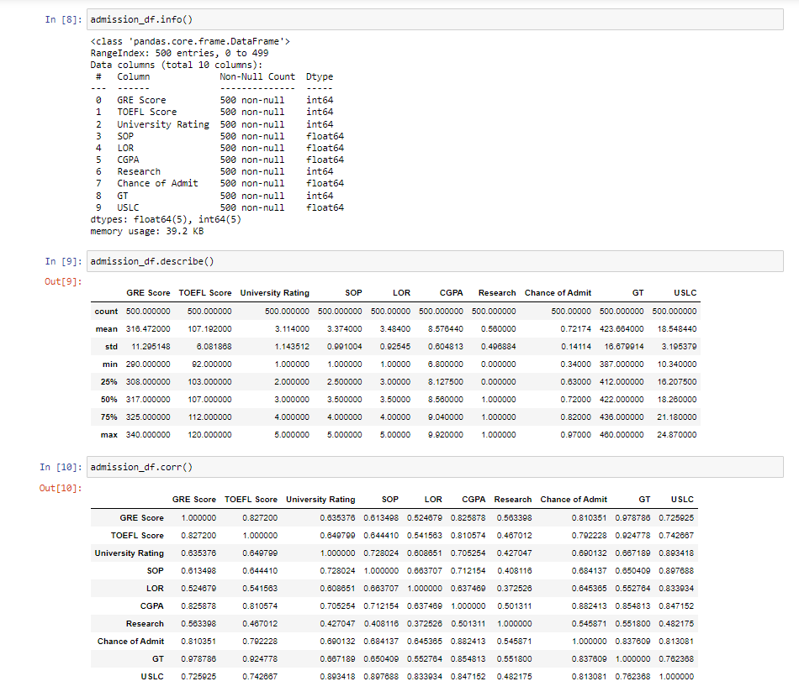
IMPLEMENTATION
1.2 Data Analysis

Slide 21
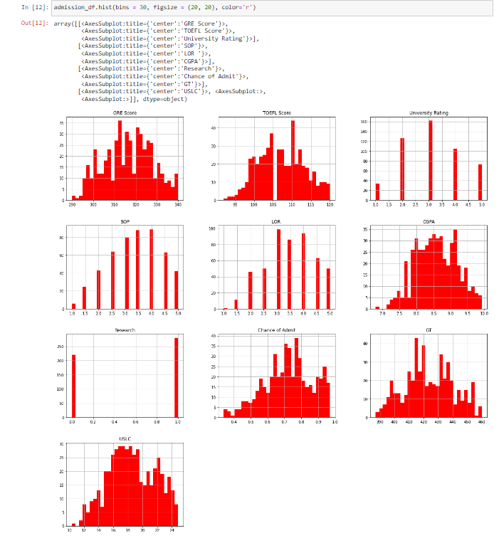
IMPLEMENTATION
2. Visualization

Slide 22
IMPLEMENTATION
3. Training Dataset

Slide 23
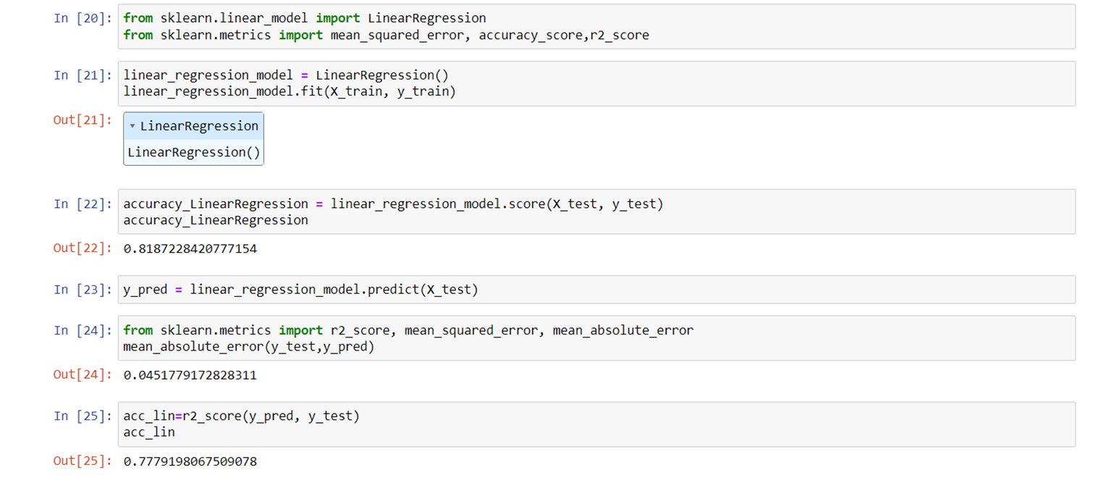
IMPLEMENTATION
4.1 Importing Linear Regression

Slide 24
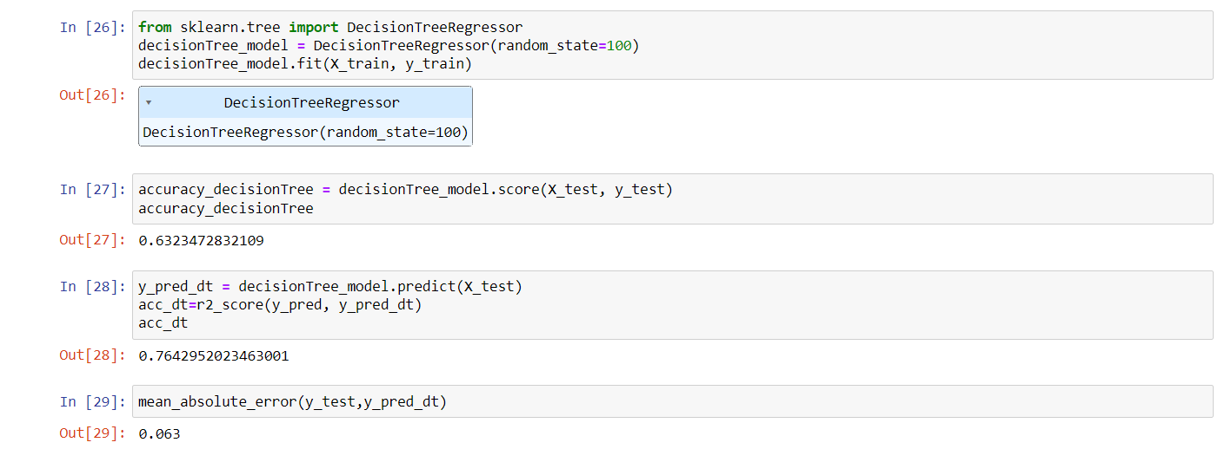
IMPLEMENTATION
4.2 Importing Decision Tree Regressor

Slide 25
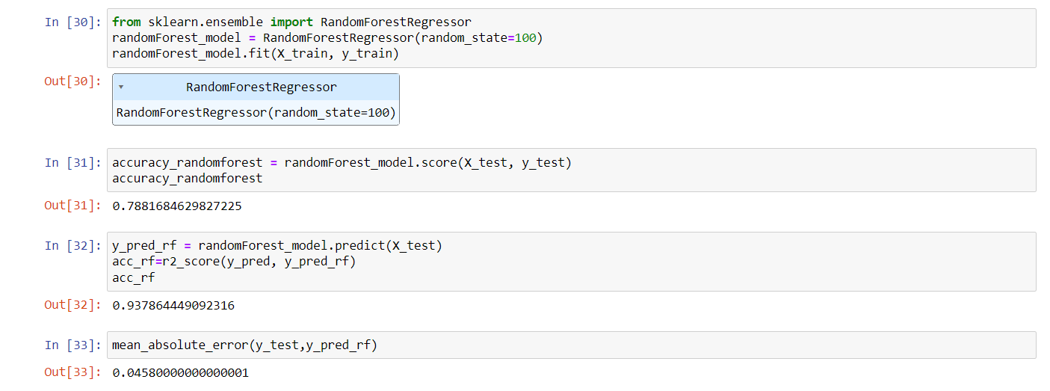
IMPLEMENTATION
4.3 Importing Random Forest

Slide 26
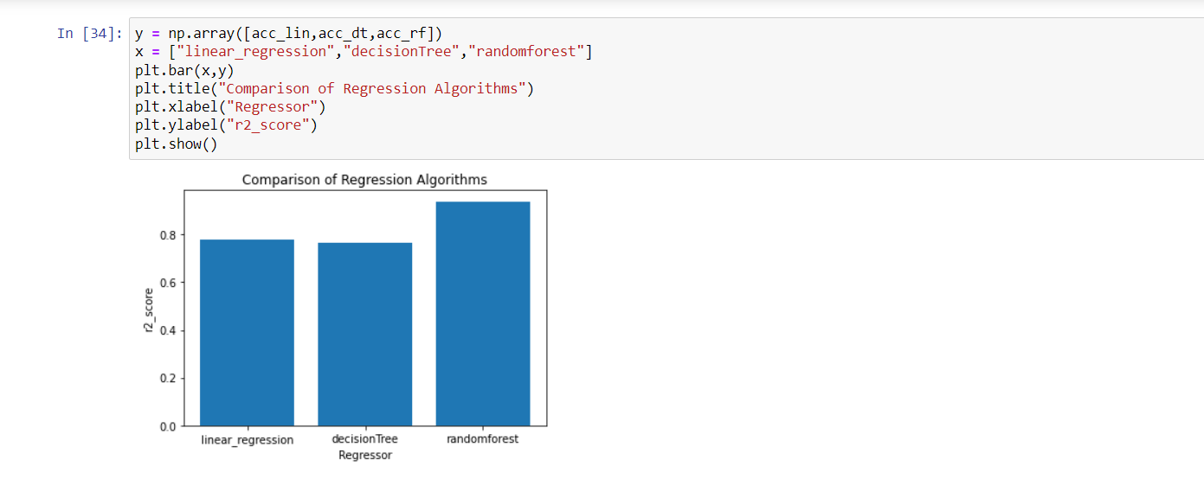
IMPLEMENTATION
5. Checking accuracy and Comparing

Slide 27
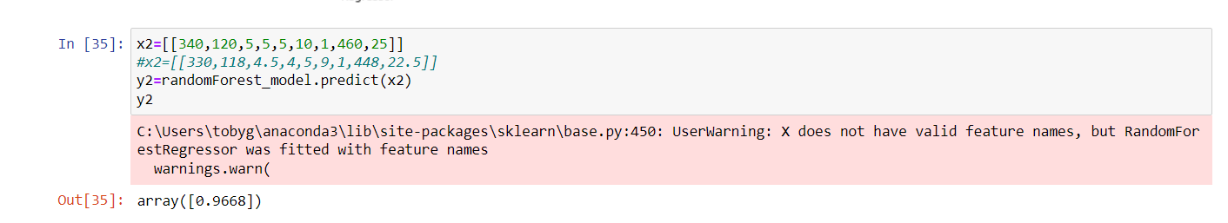
IMPLEMENTATION
6. Predicting

Slide 28
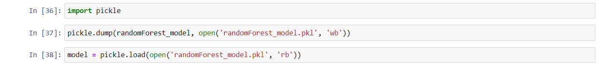
IMPLEMENTATION
7.1 Deploying

Slide 29
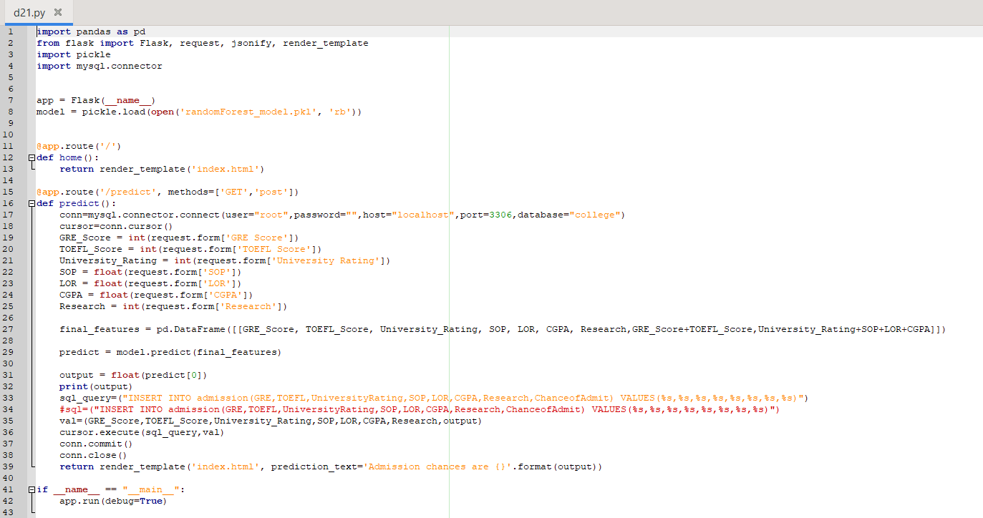
IMPLEMENTATION
7.2 App deployment and Connection to database

Slide 30
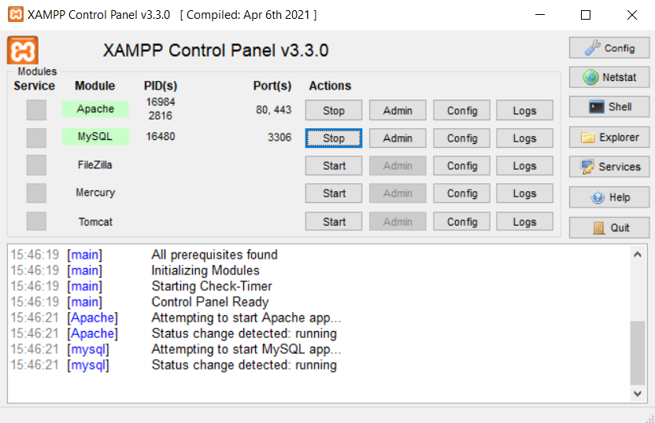
IMPLEMENTATION
7.3 File system services

Slide 31
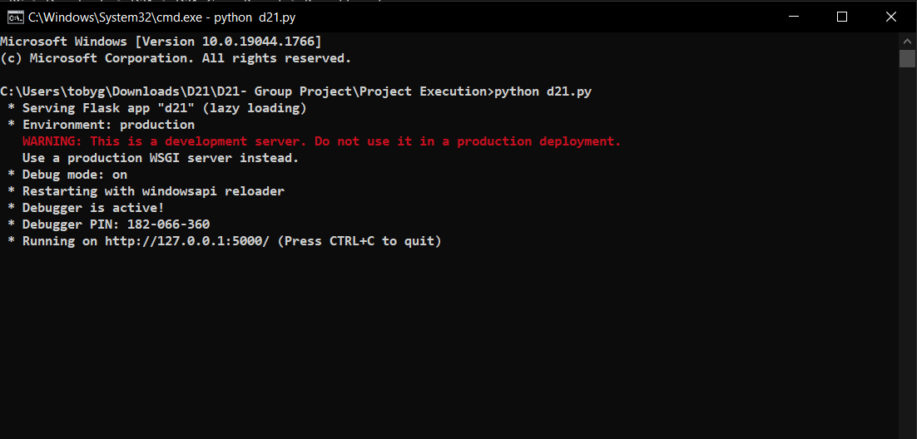
RESULT
* Executing the application

Slide 32
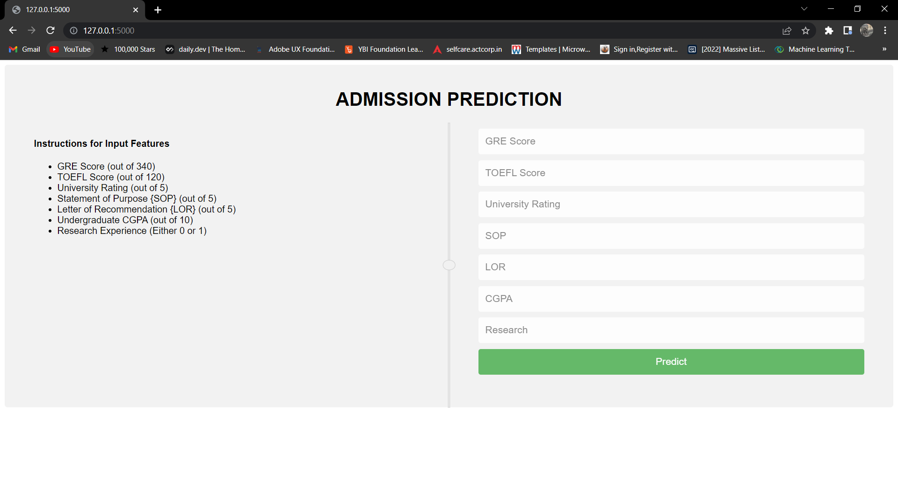
RESULT
* HTML page

Slide 33
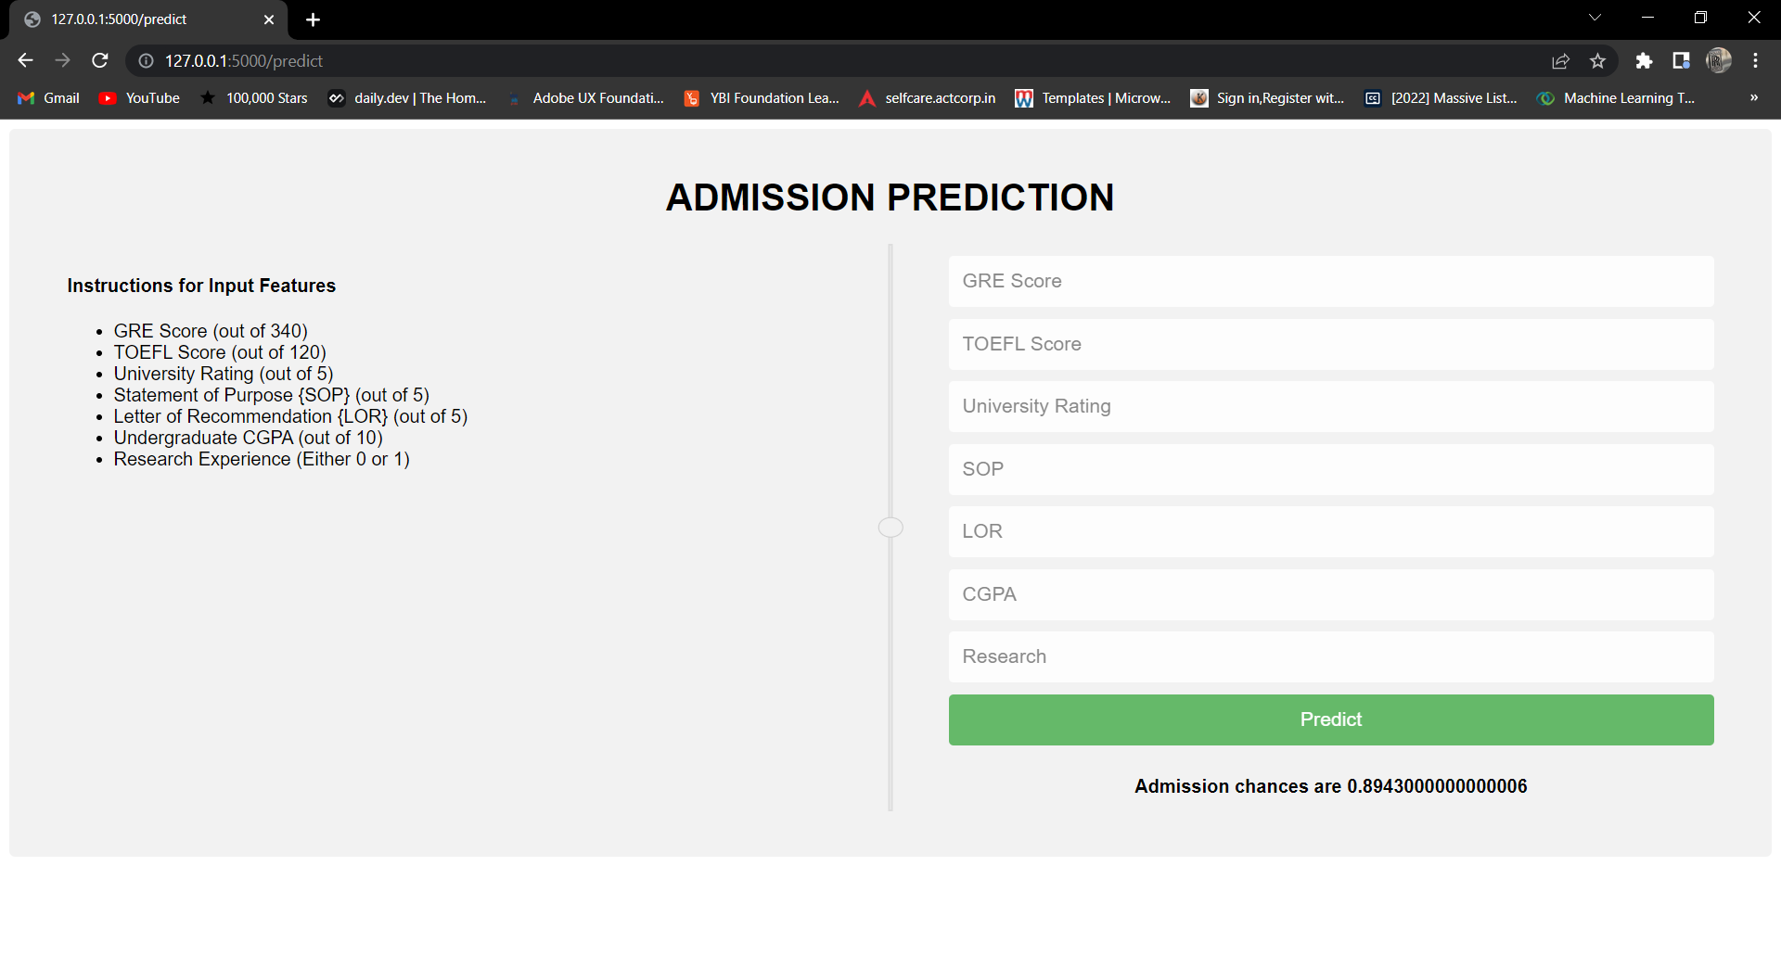
RESULT
* Entering the values and predicting the output

Slide 34
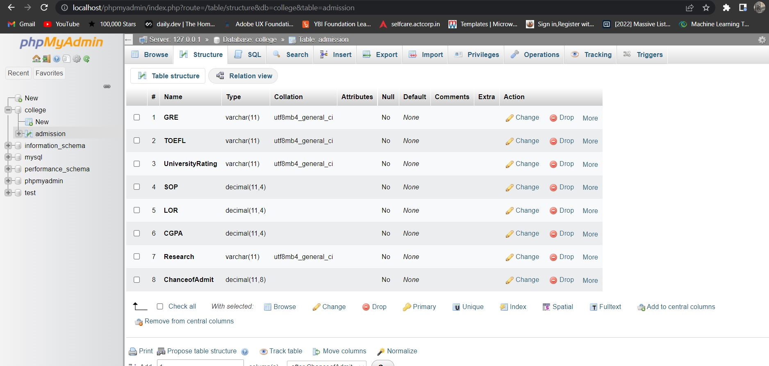
RESULT
* File system table creation and storage

Slide 35
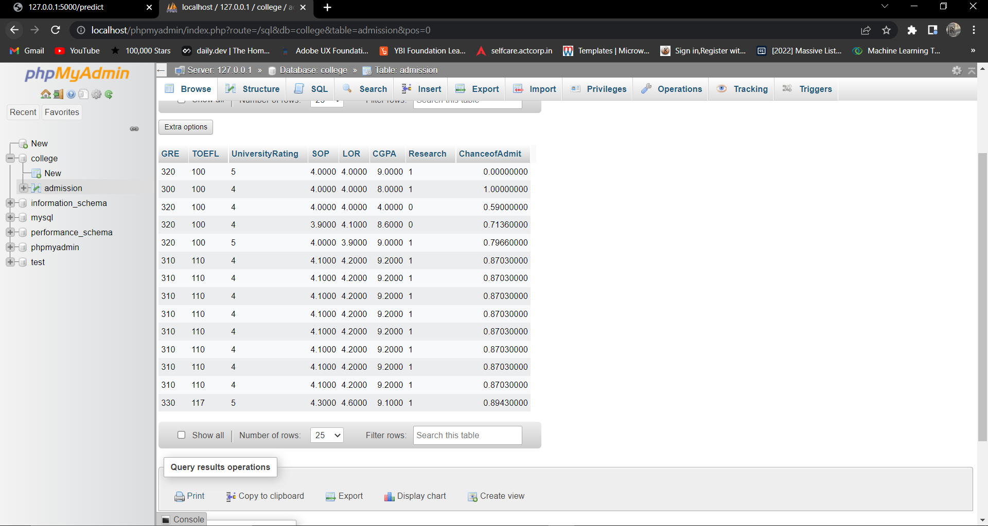
RESULT
* Storage of the output (File System)

Slide 36
PERFORMANCE ANALYSIS
MODEL | MAE/RMSE | MSE | R2 score
Linear Regression & Catboost Model | 0.04 | 0.003 | 0.84
Adaboost Model | - | - | 0.90
DNN Model | 0.03 | 0.0031 | 0.85
Proposed Model | 0.04 | 0.0038 | 0.93

Slide 37
CONCLUSION
Conclusion
Every year million of students apply to universities to begin their educational life. The experts had proposed some models and executed it. They have also published some conference and research papers. The reference has been taken from the discussed base papers. The proposed model predicts the admission according to their scores. The model’s performance has been evaluated by the R2 score. The best chosen algorithm is uses among the algorithms. Our study found that Random forest performs very well for this project. We have also developed a HTML page and a file system to store the previous data which is predicted by user input. This is a project with good future scope, especially for the students of our age group who want to pursue their future goals in a good reputed university. In the future, we plan to improve the model by different parameters to advise students to join the University of their choice.

Slide 38
REFERENCES
https://ieeexplore.ieee.org/document/7924718
https://ieeexplore.ieee.org/document/9418279
https://ieeexplore.ieee.org/document/6234369
https://ybifoundation.org/course/python-fundamentals
https://ybifoundation.org/course/machine-learning-fundamentals
https://trainings.internshala.com/python-course/?tracking_source=trainings-cards-most-popular
https://scikit-learn.org/stable/
https://www.geeksforgeeks.org/how-to-read-data-from-a-file-stored-in-xampp-webserver-using-php/
https://community.apachefriends.org/f/viewtopic.php?f=16&t=34468

Slide 39
THANK YOU

